Slide 1
Finite Automata
See Sections 2.1 and 2.2

Slide 2
Let's start with an example:
a
T
b
S
b
b
start
U
Here you see labeled circles that are states, and labeled arrows that are transitions. One of the states is marked "start". One of the states has a double circle; this is a terminal state or accept state.
To process a string with this automaton, begin in the start state at the start of the string. Walk through the letters of the string, taking the transitions labeled with the letters. If you are in an accept state at the end of the string, accept it; otherwise reject it.

Slide 3
a
T
For example, on string "abbb" we go through the states SSTUT and end in an accept state, so we accept "abbb". On the other hand, with string "bb" we go through states STU and we do not accept.
b
S
b
b
start
U
With string "abab" we start in state S, stay in S on input 'a', go to state T on input 'b' and then have nowhere to go on input 'a'. Again, we do not accept the string. The only strings accepted are those for which the automaton consumes all of the letters in getting to an accept state.

Slide 4
a
T
The usual question for a finite automaton is "What is the language accepted by the automaton?"
b
S
b
b
start
U
The language accepted by this automaton is the set of strings with any number of a's followed by an odd number of b's.

Slide 5
In general, a "Deterministic Finite Automaton" or DFA is a quintuple (Q, Σ, δ, s, F) where
Q is a finite set of states
Σ is an alphabet of symbols
δ is a transition function whose inputs are a state and an element of Σ and whose output is a state. This is represented by the arrows in our diagrams.
s is one of the states in Q. This is our start state. Note that there is only one start state in an automaton.
F is the set of accept, or final states.

Slide 6
A DFA processes strings in Σ* as follows: Let w=a₀a₁...a_{n-1} be a string in Σ*. Let q₀ be s (the start state), and for i > 0 let q_{i} = δ(q_{i-1},a_{i-1}) The last state is q_{n}. If q_{n} is an element of F accept the string w.
This definition assumes there is a transition from every state on every element of S. We can make any automaton fit this by adding for any missing transition a transition to a "dead" state from which there is no exit.
a,b
a
T
a
b
S
dead
b
b
start
U
a

Slide 7
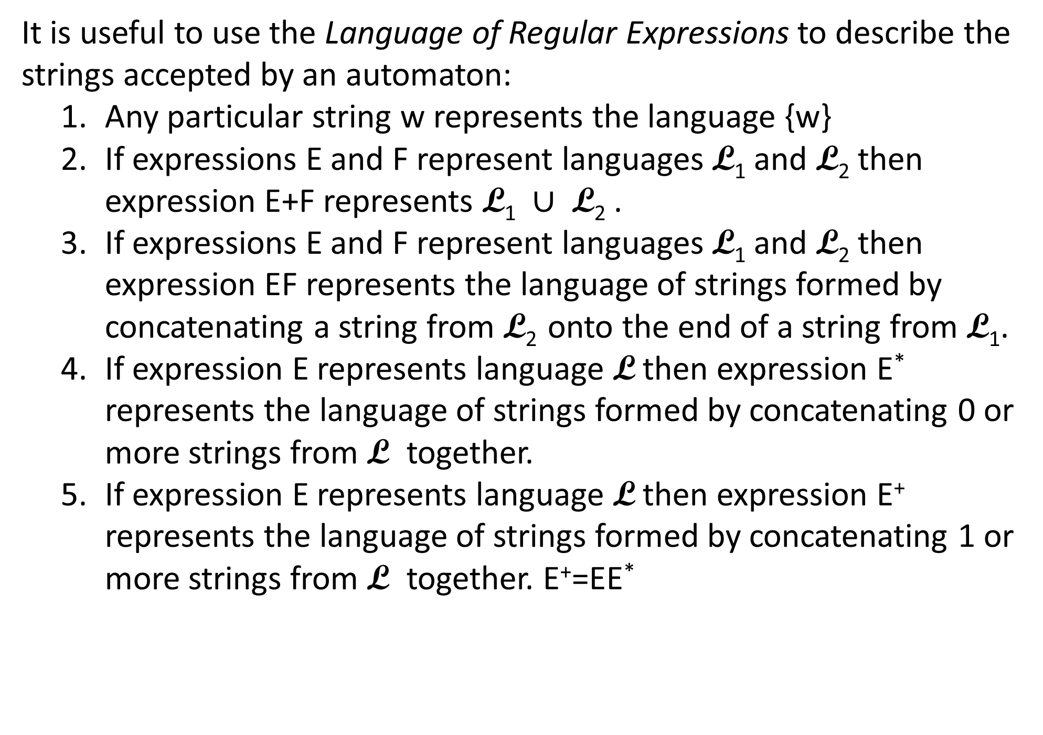
It is useful to use the Language of Regular Expressions to describe the strings accepted by an automaton:
  Any particular string w represents the language {w}
  If expressions E and F represent languages L₁ and L₂ then expression E+F represents L₁ $∪$ L₂ .
  If expressions E and F represent languages L₁ and L₂ then expression EF represents the language of strings formed by concatenating a string from L₂ onto the end of a string from L₁.
  If expression E represents language L then expression E* represents the language of strings formed by concatenating 0 or more strings from L together.
  If expression E represents language L then expression E⁺ represents the language of strings formed by concatenating 1 or more strings from L together. E⁺=EE*

Slide 8
Example 1.
a
T
b
S
b
b
start
U
We said before that this accepts the language of any number of a's followed by an odd number of b's. This language is represented by the regular expression a*b(bb)*

Slide 9
Example 2
1
0
S
T
U
1
start
This accepts 10(10)* = (10)⁺

Slide 10
Example 3
a
a
b
S
T
b
start
This accepts strings with an even number of b's:
( a*(ba*b)* )*

Slide 11
Example 4: Find a DFA that accepts 101, 11010, and nothing else.
1
0
1
S
T
U
V
start
1
0
1
Y
0
W
X
Z
Note that by imitating this example you could make a DFA that accepts any particular finite language.

Slide 12
Note that it is easy to write a program that simulates a DFA's actions on a string. You might have one variable that represents the current state and a for loop that iterates through the letters of the string. For a simple DFA with only a few states you might have a big conditional statement that checks the various cases: if you are in state foo with input letter bar change the state to fee. For a more general automaton represent the transition function by a 2D table whose rows are indexed by the states and whose columns are indexed by the alphabet letters. Table[foo][bar] is the state to transition to if you are in state foo and see input letter bar.

Slide 13
Definition: We say that a language is regular if it is the language accepted by some DFA.
For examples:
  Σ* is regular for any finite alphabet Σ.
  Every finite language is regular.
  10*1 is regular.
  Strings of 0's and 1's with an even number of 1's is regular.

Slide 14
Which of the following are regular? For each let the alphabet be {0,1}
Note that we can show a set is regular by producing the DFA that accepts it. We don't have a way to show a set isn't regular. We will.
  Strings of length 2? yep
  Strings of even length? yep
  Strings of prime length?
  Strings with the same number of 0's as 1's?
  Strings with more 0's than 1's?
  Strings that contain 010 as substrings? yep
  Strings with no more than 2 0's? yep
  Strings with at least 2 0's? yep
  Strings that are palindromes?
  Strings that are palindromes of length 6 or less? yep

Slide 15
Of course, we would like some way to characterize the languages that are regular so we could determine if a language is not regular.

